Slide 1
WILLIAM
( ͡° ͜ʖ ͡°)
Group 5
Mauricio Deguchi, Damian Magana, Stephen Masson, Jeff Purchatzke, Matthew Wang, Yulong Yu

Slide 2
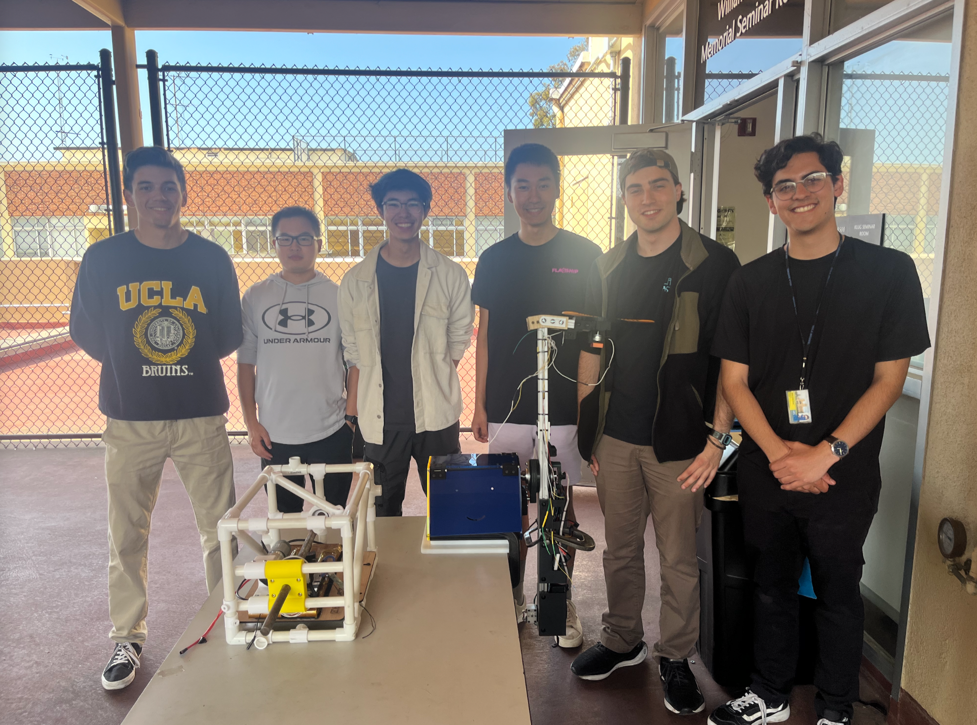
TABLE OF CONTENTS
Project Goals
Design Overview
CAD
Electronics/Code
Preliminary Testing
Arm Testing
Throwing Boomerangs in Field
Post-Mortem

Slide 3
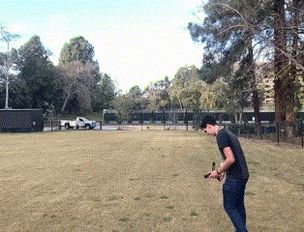
PROJECT GOALS
Baseline Objectives:
Robot throws a boomerang
Must go out at least 20 meters
Must land within a 3 meter radius
Wind sensor for manual adjustment
Provide user with suggestions for optimal flight
Reach Objectives:
Autonomously adjusts from wind data
Catching the boomerang

Slide 4
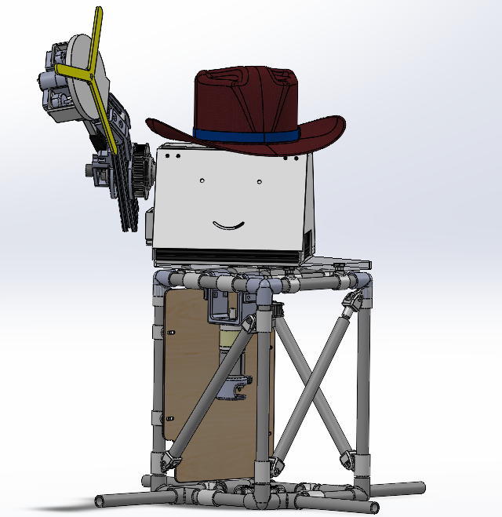
FINAL CAD ASSEMBLY

Slide 5
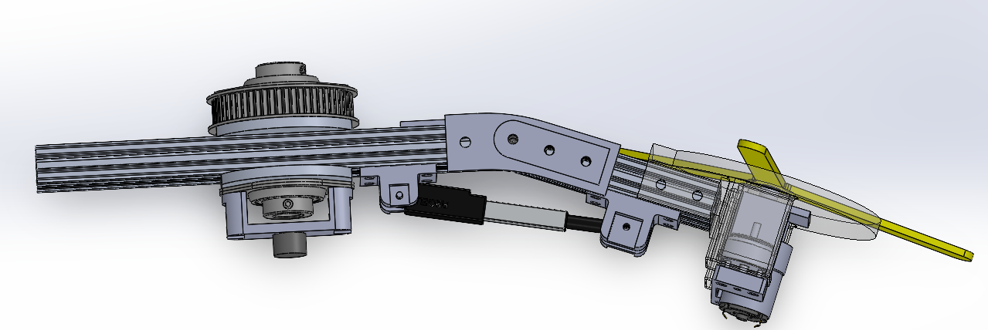
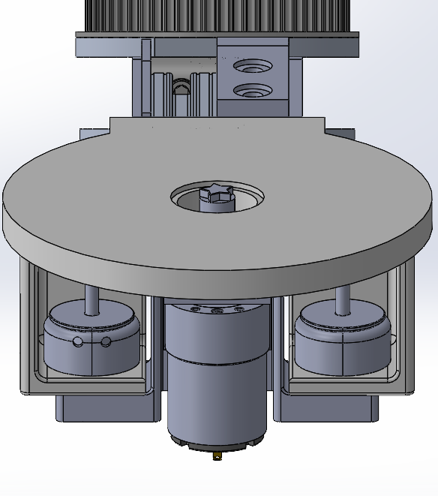
ARM ASSEMBLY
Solenoid release mechanism
Star pin fit
Arm motor for linear velocity and pitch angle
3.75:1 Gear ratio
Wrist motor for rotational velocity
Linear actuator for roll angle

Slide 6
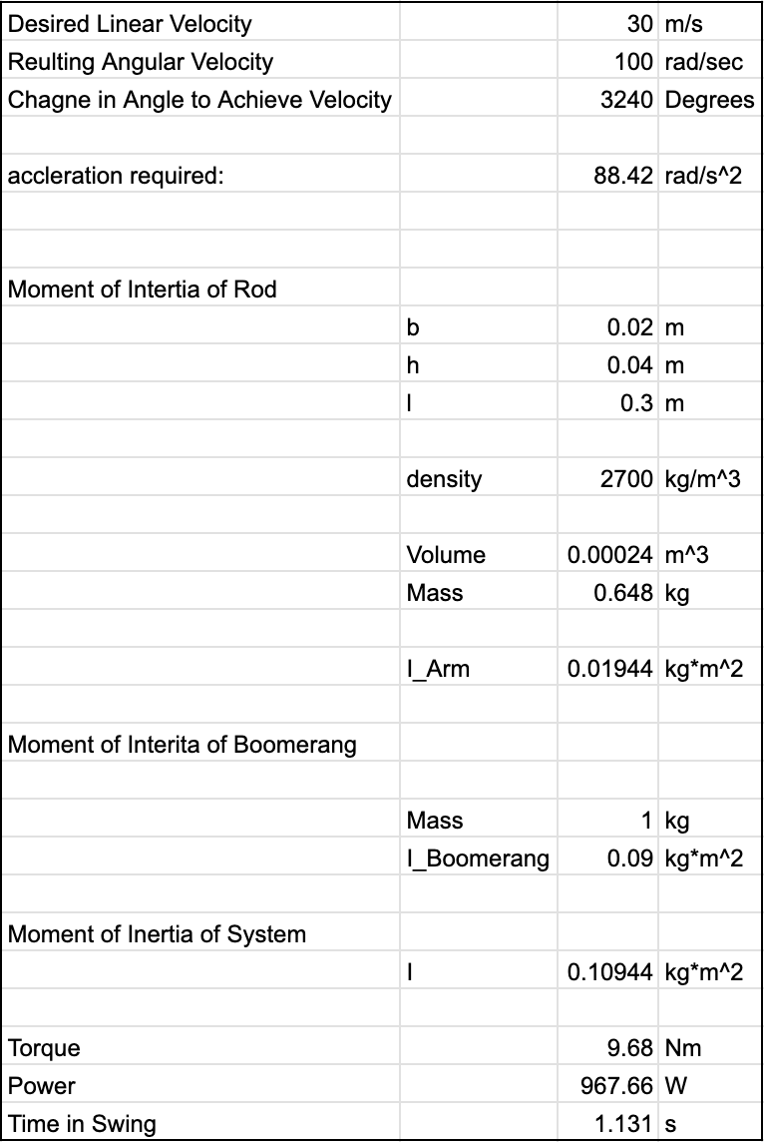
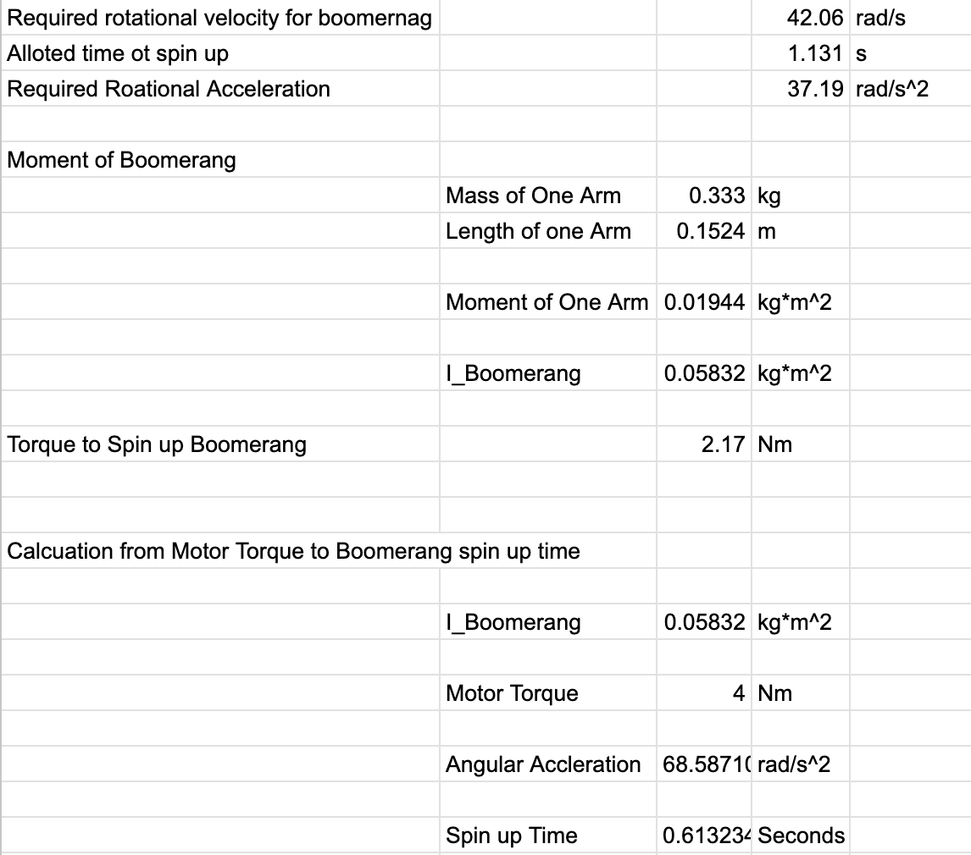
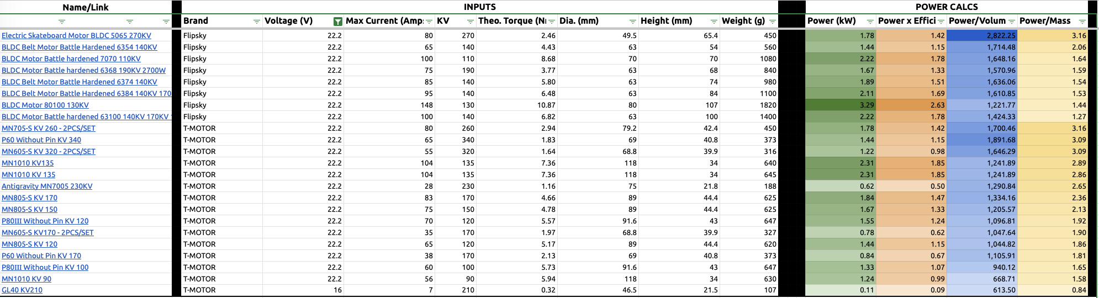
CALCULATIONS
WE DID THEM…

Slide 7
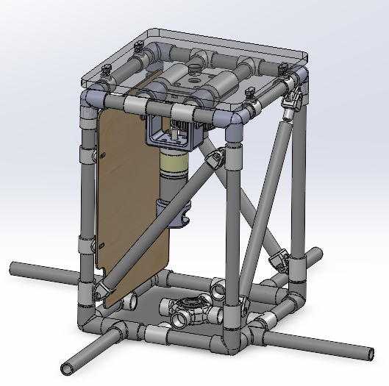
BASE ASSEMBLY
PVC frame, 10x10x15 in
Mounted to ground with extension members / stakes
DC gear motor provides yaw control
Frame material switched from 8020 to wood to PVC
Easier manufacturing/assembly
Reduced cost
Arm vibrations at higher RPMs and with extended arm proved problematic

Slide 8
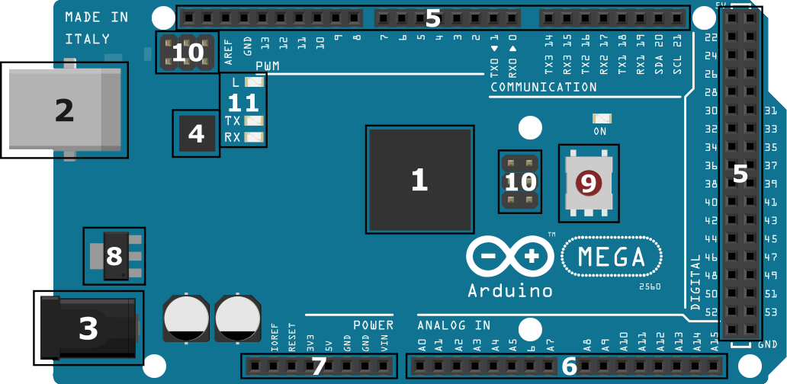
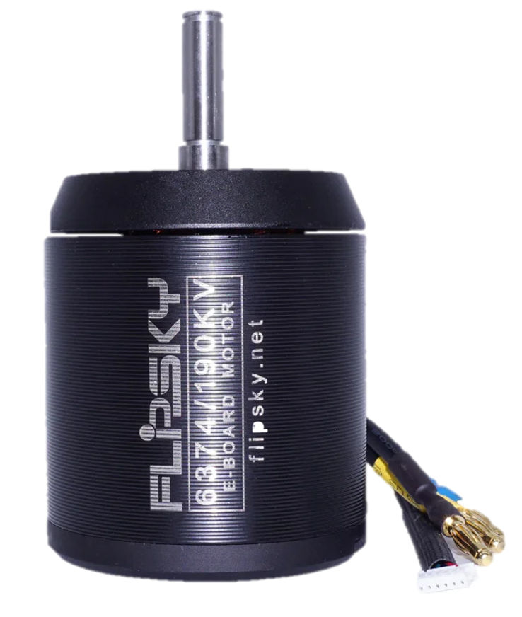

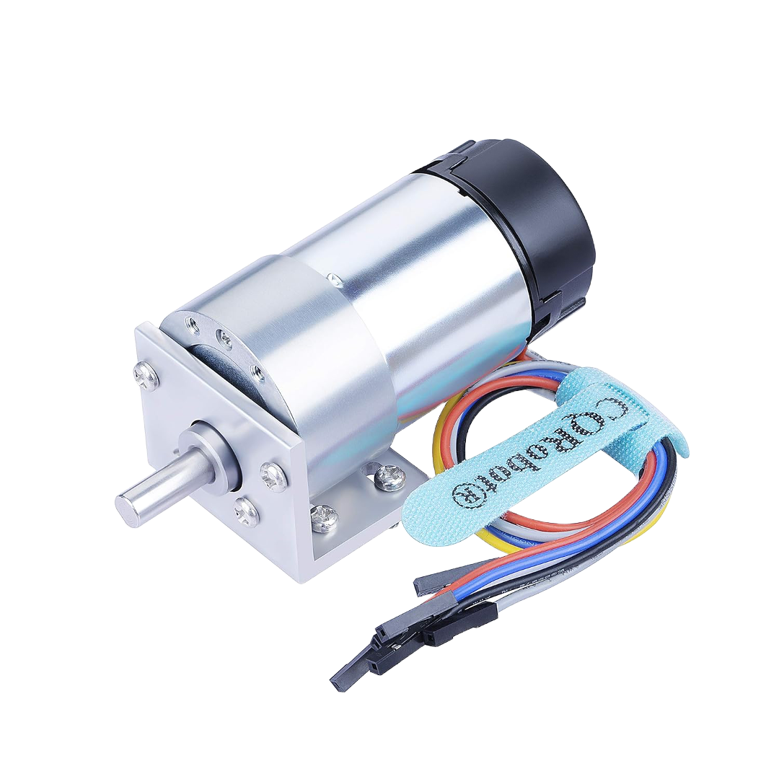
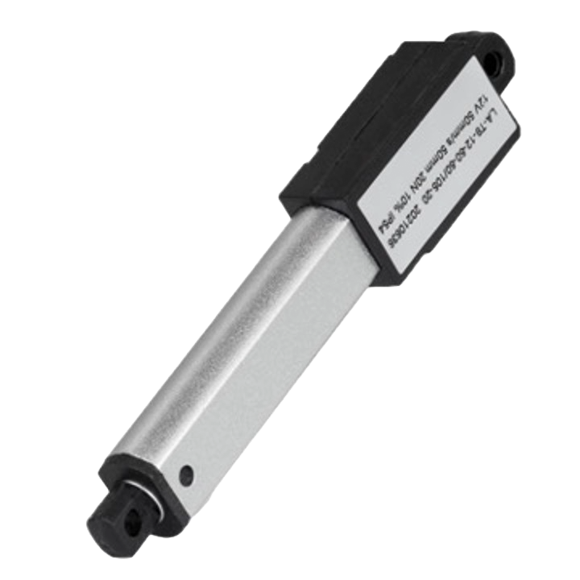
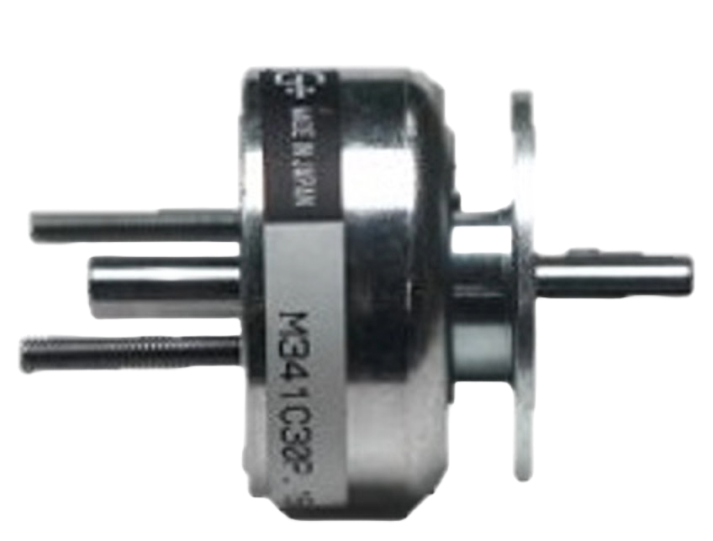
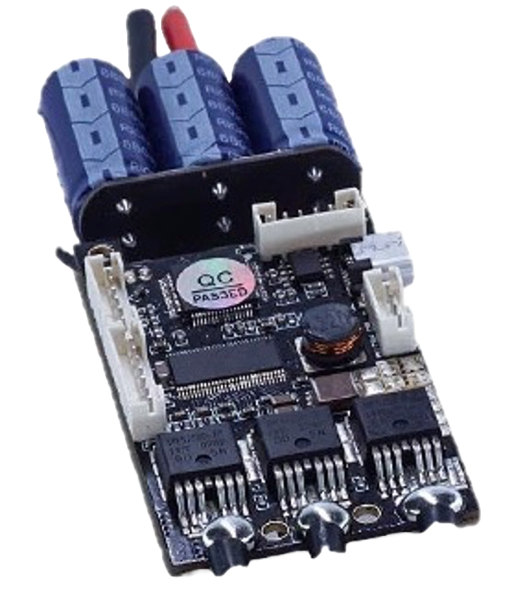
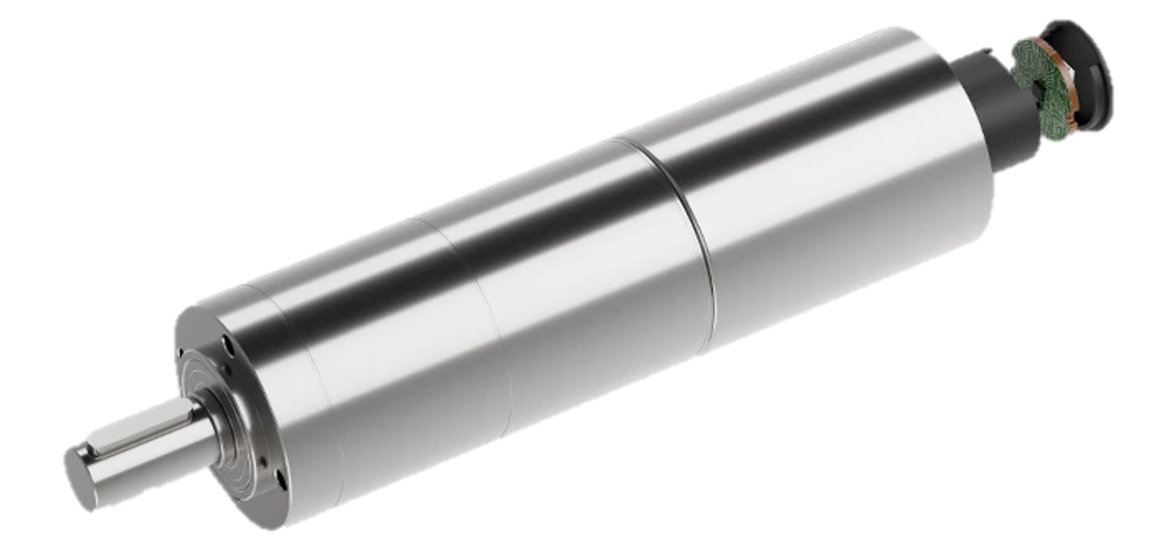
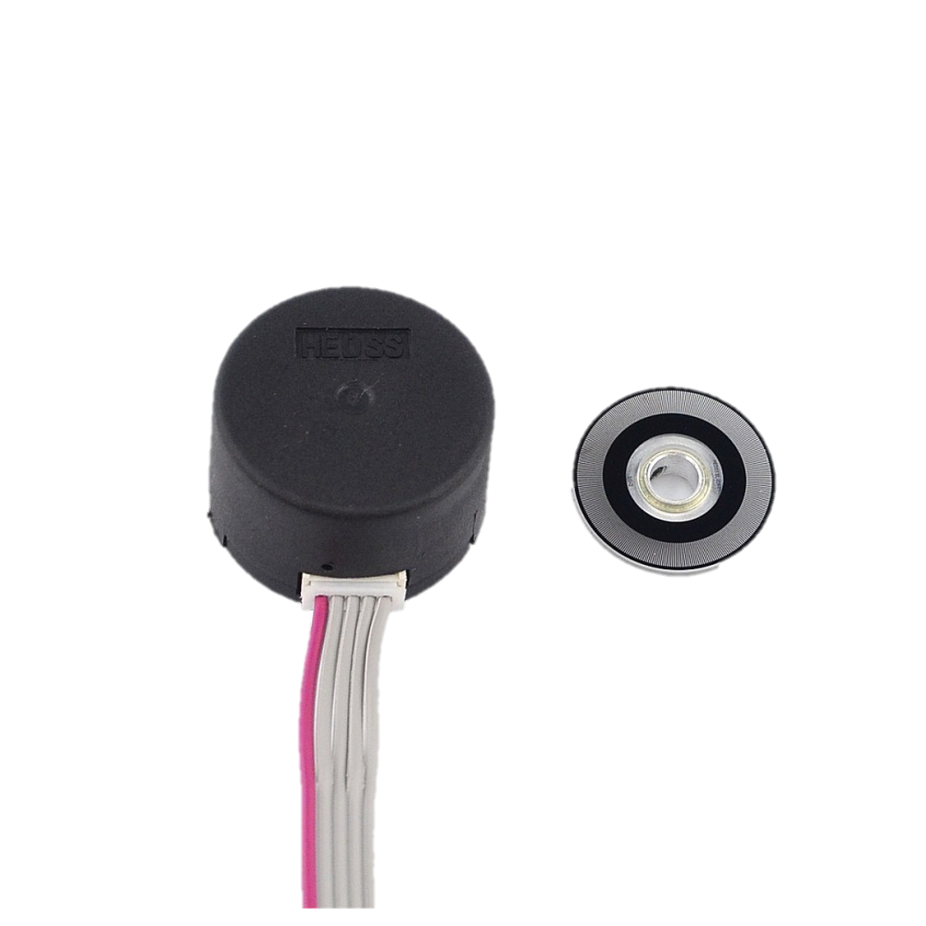
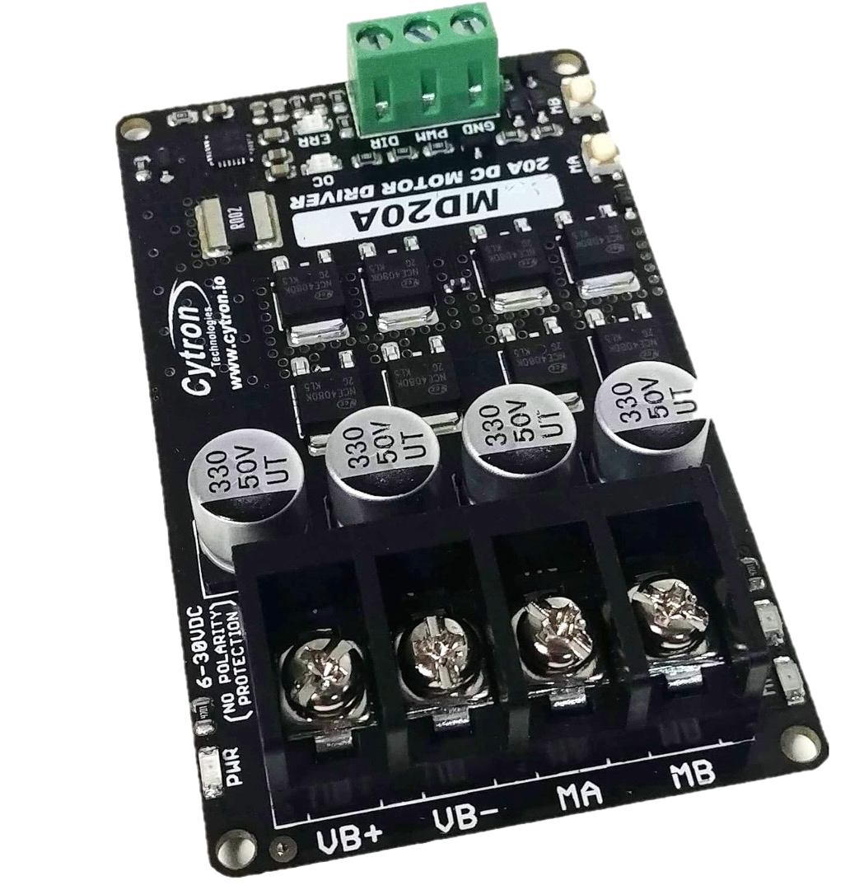
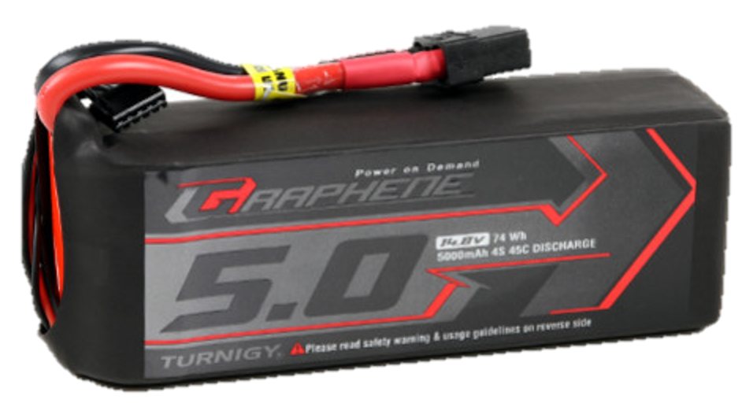
ELECTRONICS OVERVIEW
Arm Electronics
Arduino Mega
Base Electronics
Brushed Motor w/ Encoder
Linear Actuator
Solenoids x2
Arduino Uno
Electric Skateboard Motor
300 ppr Optical Encoder
Brushed Motor Driver
4S LiPo Battery
VESC Motor Driver
DC Gear Motor

Slide 9
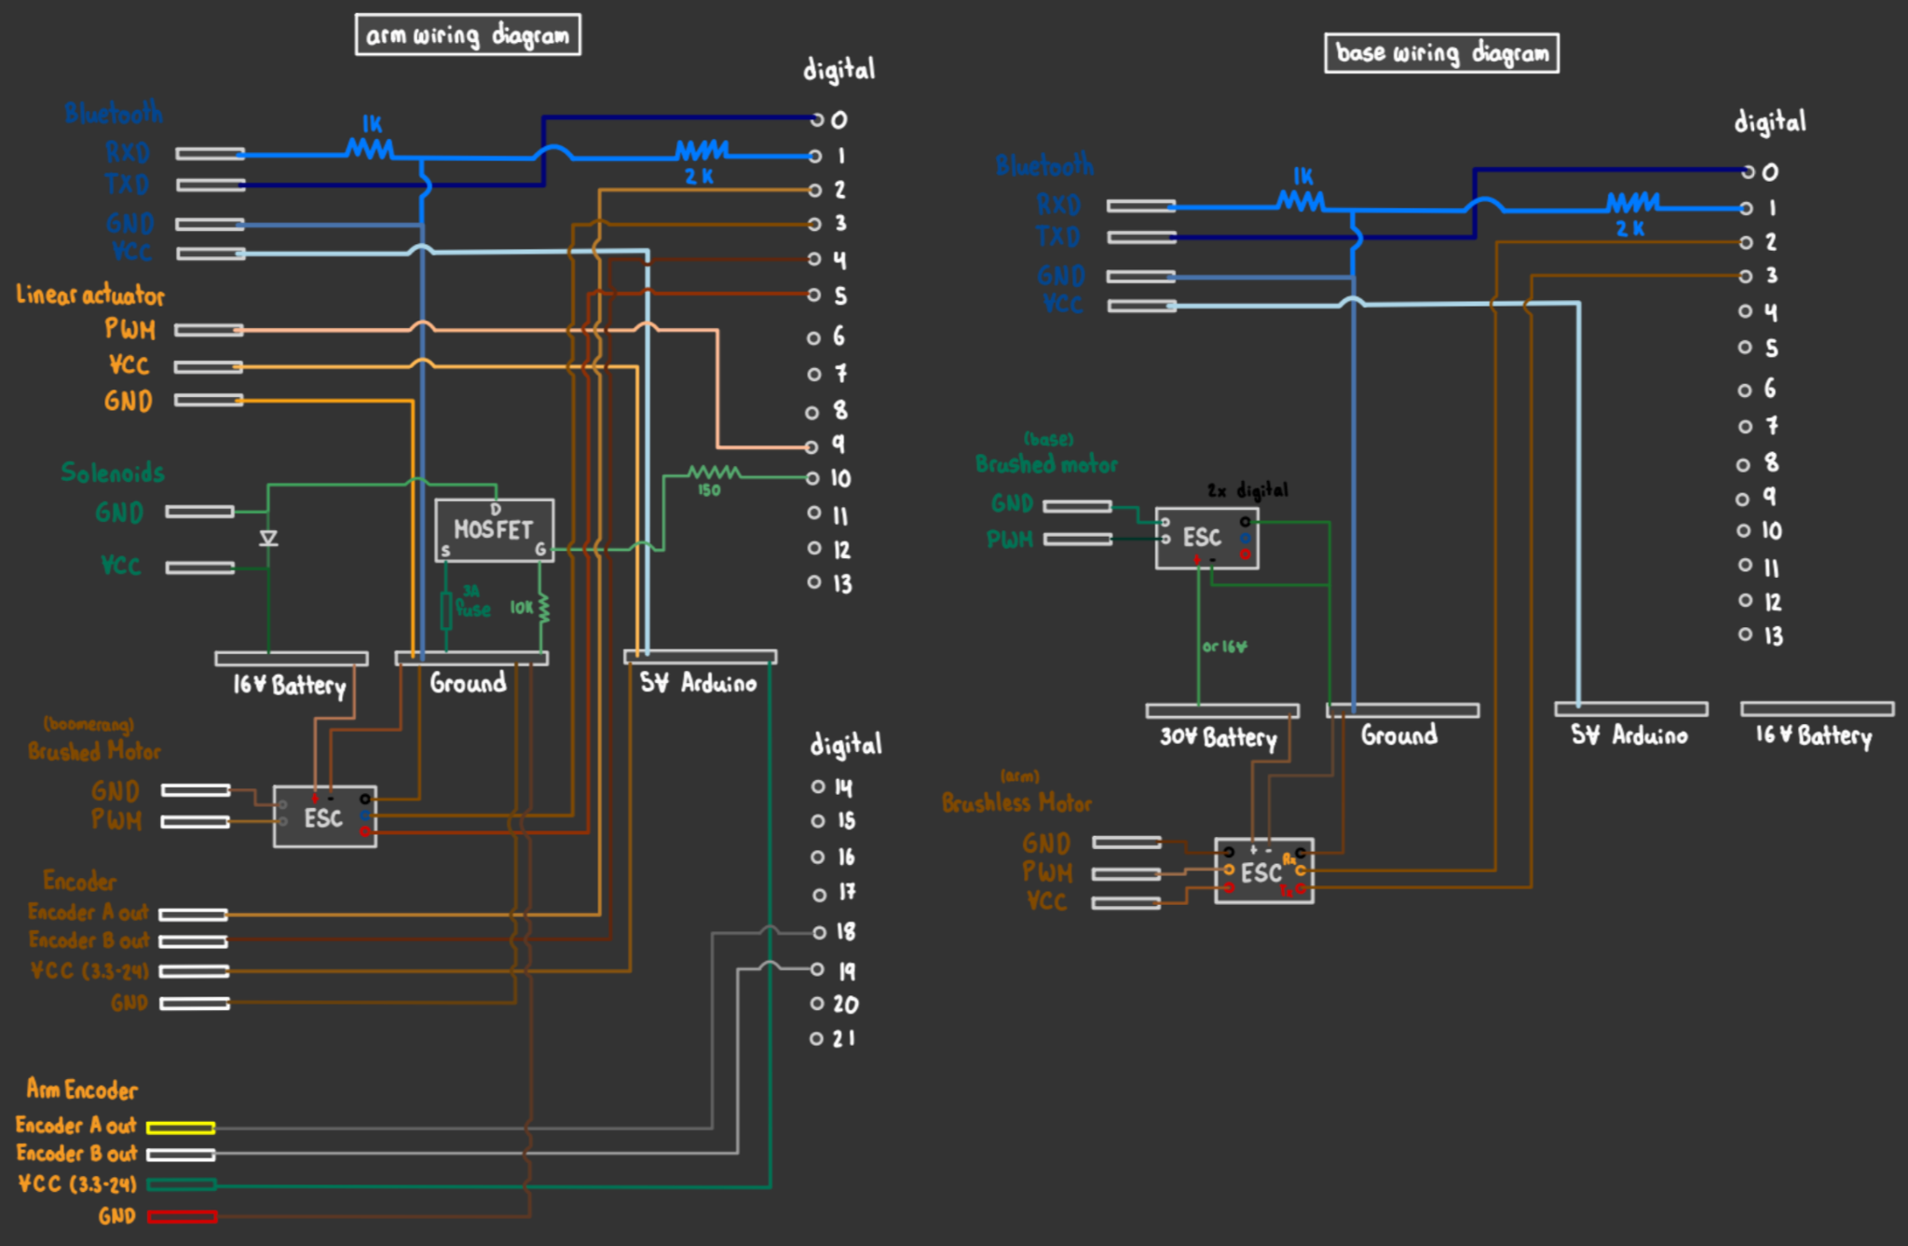
ELECTRONICS WIRING

Slide 10



CODE OVERVIEW
Set Arm RPM
Set Yaw Angle
Base Arduino
Set Boomerang RPM
Manually Fire Solenoids
Track Angle to Fire
Arm Arduino
Set Linear Actuator Position
Feedback to the user

Slide 11
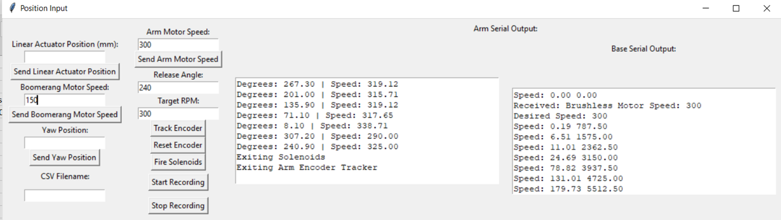
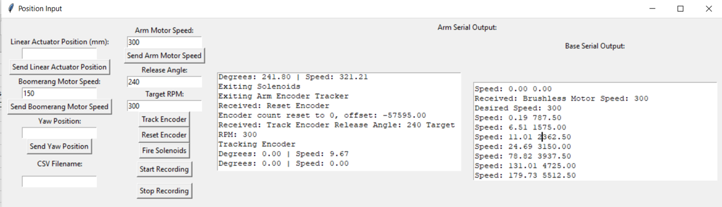
USER INTERFACE

Slide 12
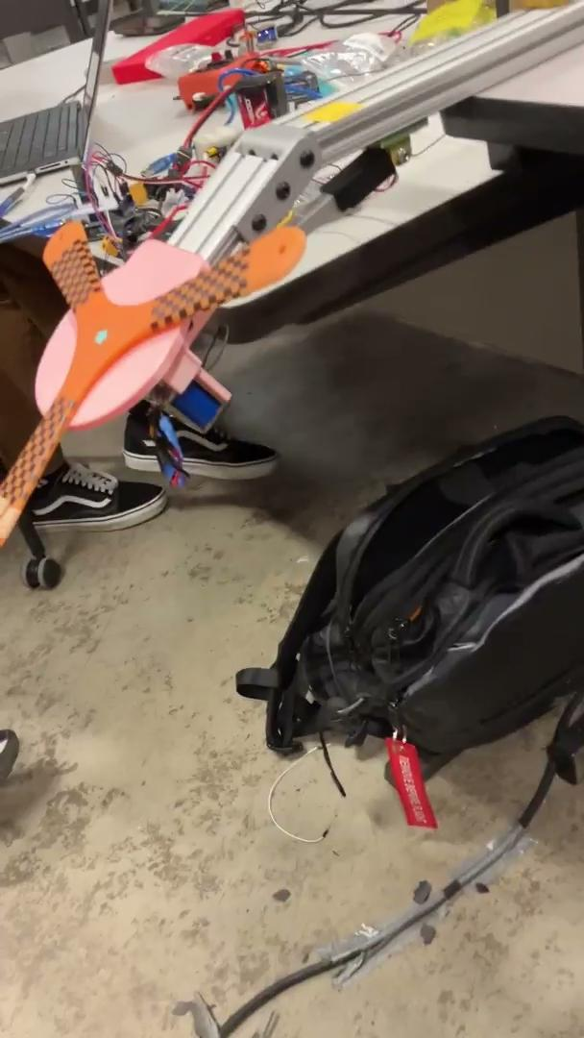
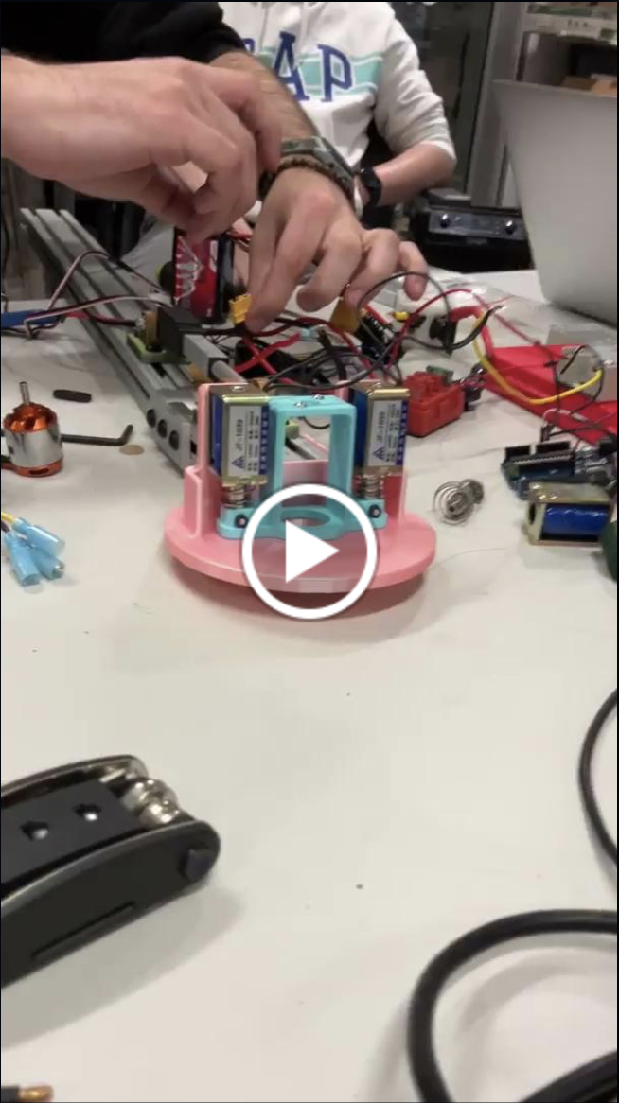
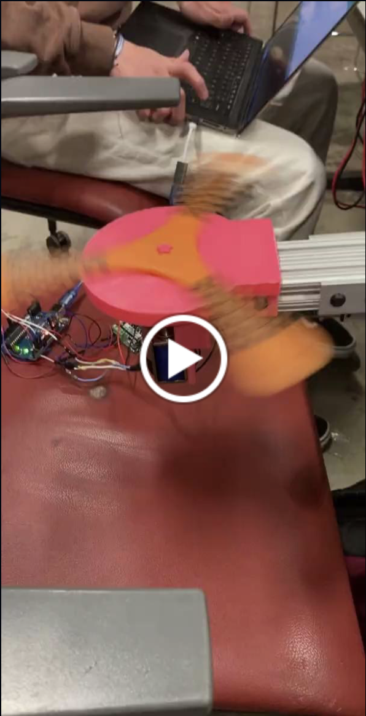
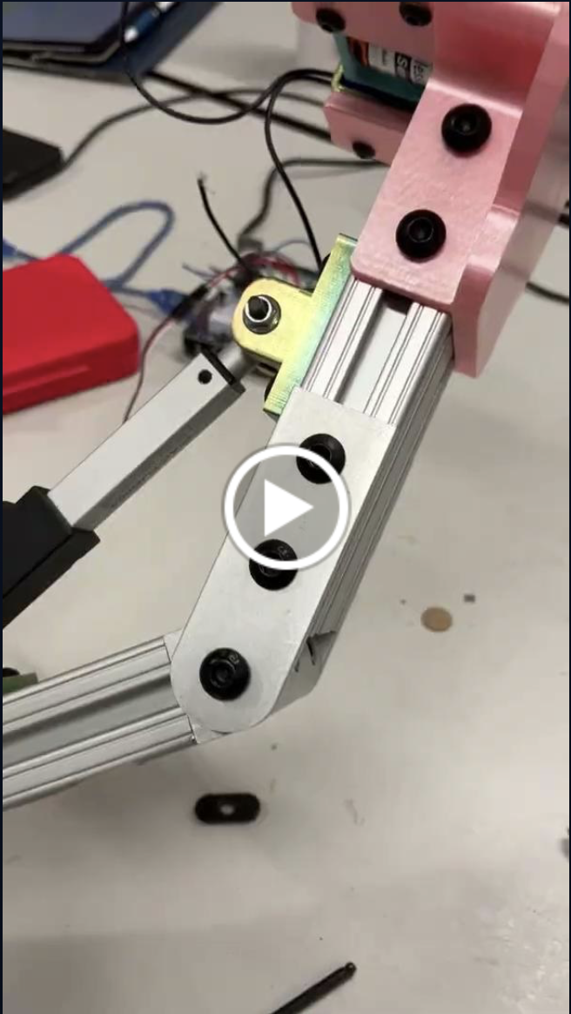
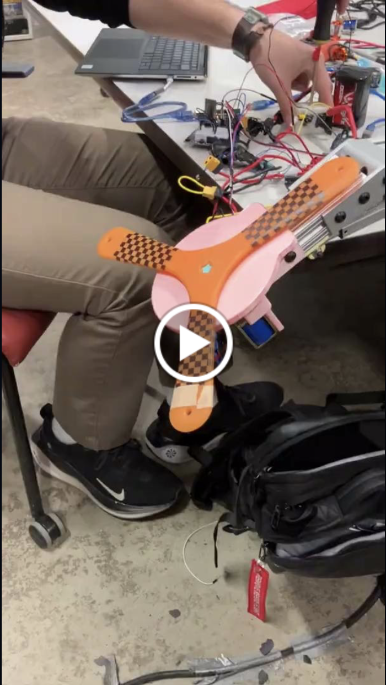
PRELIMINARY TESTING
Small Wire = Fuse
Brushed Motor
Brushless Motor
Linear Actuator
15N Solenoids Firing

Slide 13
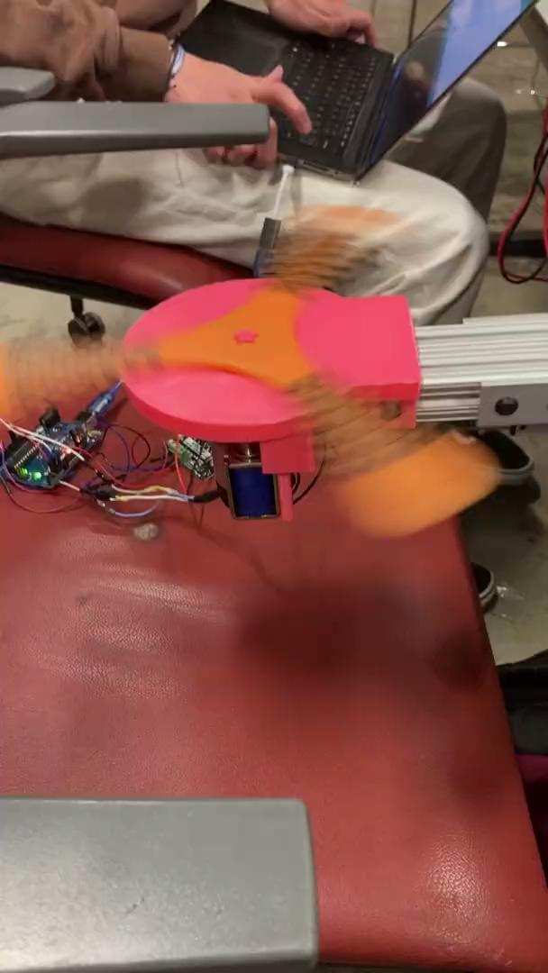
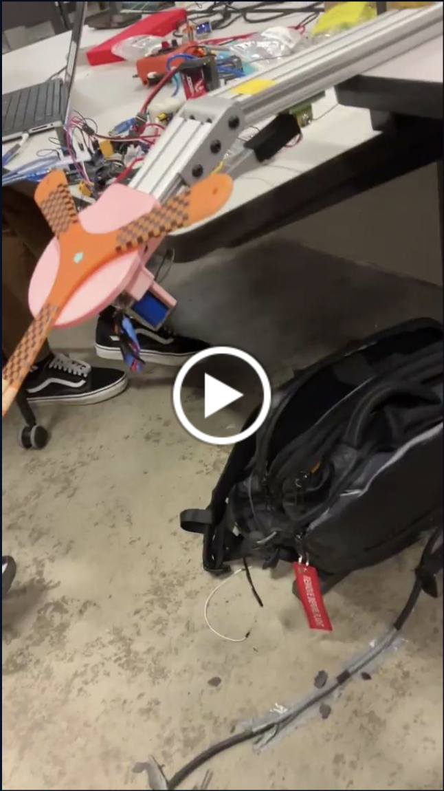
PRELIMINARY TESTING
Brushless Motor
Small Wire = Fuse
Brushed Motor
Linear Actuator
15N Solenoids Firing

Slide 14

PRELIMINARY TESTING
Brushless Motor
Small Wire = Fuse
Linear Actuator
Brushed Motor
15N Solenoids Firing

Slide 15
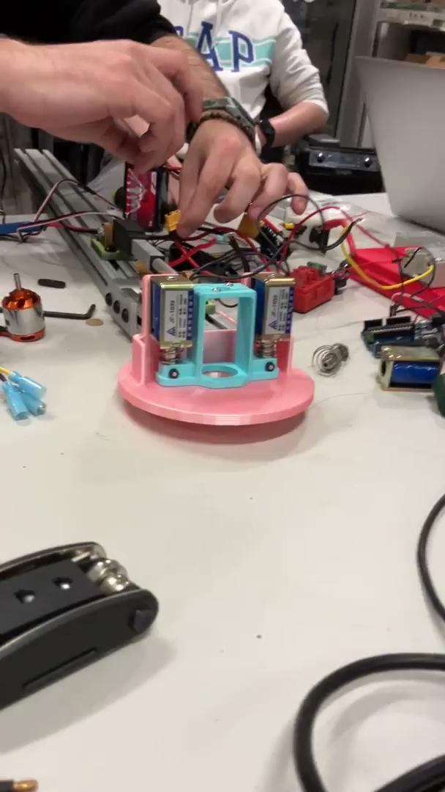
PRELIMINARY TESTING
Brushless Motor
Brushed Motor
Small Wire = Fuse
Linear Actuator
15N Solenoids Firing

Slide 16

PRELIMINARY TESTING
Brushless Motor
Small Wire = Fuse
15N Solenoids Firing
Brushed Motor
Linear Actuator

